Slide 1


Surrogate Physics Modeling for Heat Exchanger Optimization: Accelerating Design Exploration via Inverse Design
ASME 2025 Student Hackathon
A++ Team
Amirhossein Iranmehr
Armin Hassanirad

Slide 2
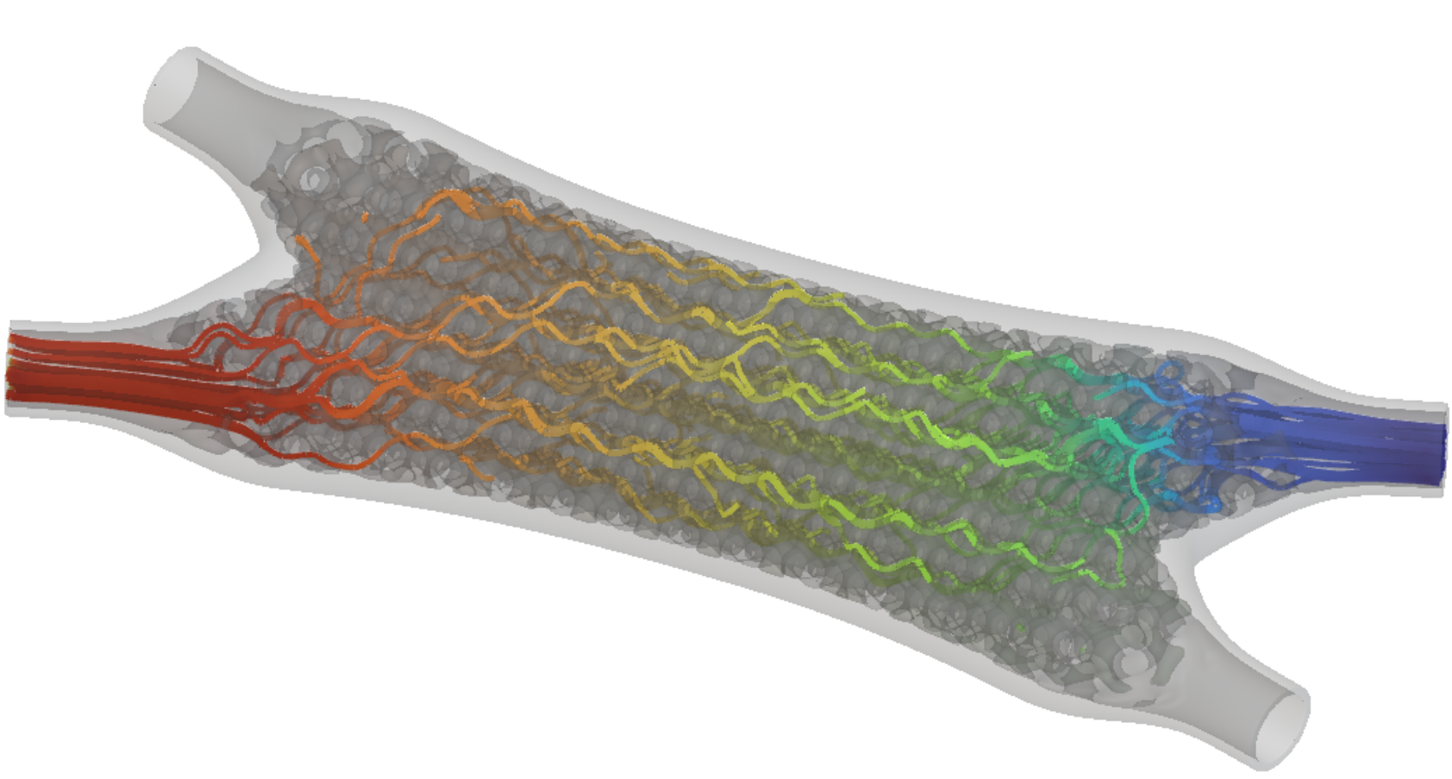
Overview
Problem statement
Review of previous works
Primary Exploratory Data Analysis (EDA)
Secondary EDA
Model setup
Model prediction
Inverse design
Potential applications and broader implications
Key takeaways
© nTOP

Slide 3
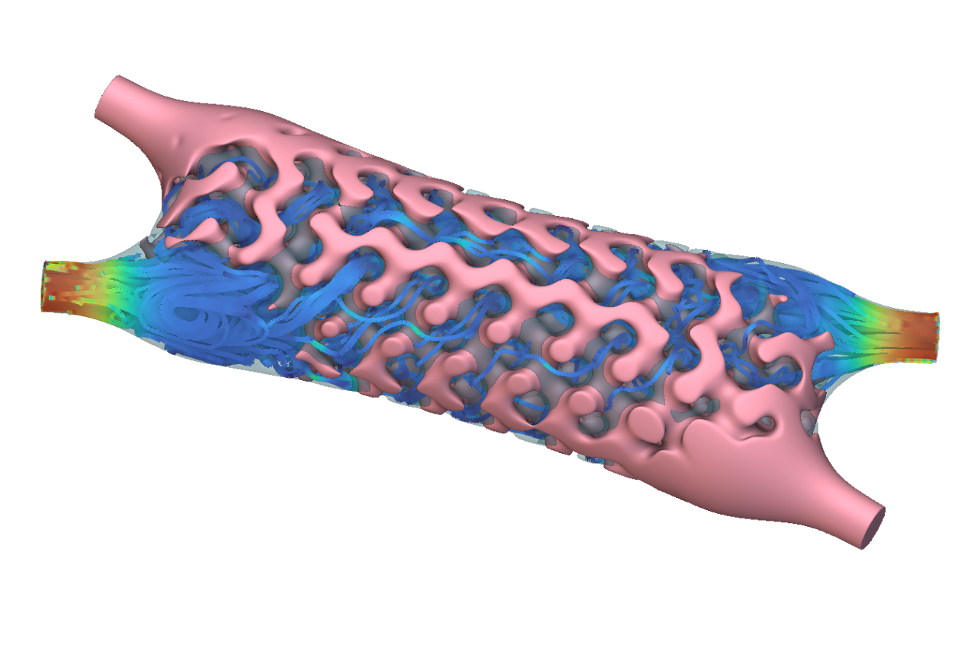
Problem Statement
HEXs Conventional Design
CFD, high computational cost, and time-intensive
Limited scalability
Design of HEXs via surrogate physics models
Dataset provided by nTop
Train a model to predict flow and geometry properties
© nTOP

Slide 4
Review of Previous Works
Study & Year | Method / Algorithm | Application | Key Outcome
Jeon et al. (2022) | Residual-based Physics-Informed Transfer Learning (RePIT) | CFD acceleration in industrial simulations | Reduced computational cost while maintaining accuracy
Kwon et al. (2020) | Random Forest | Predict convection heat transfer coefficients in cooling channels with rib roughness | Rapid multi-variable predictions without deep simulations
Krishnayatra et al. (2020) | k-Nearest Neighbor (k-NN) | Predict efficiency & effectiveness of axial finned-tube heat exchanger | High accuracy and effective geometry optimization tool

Slide 5
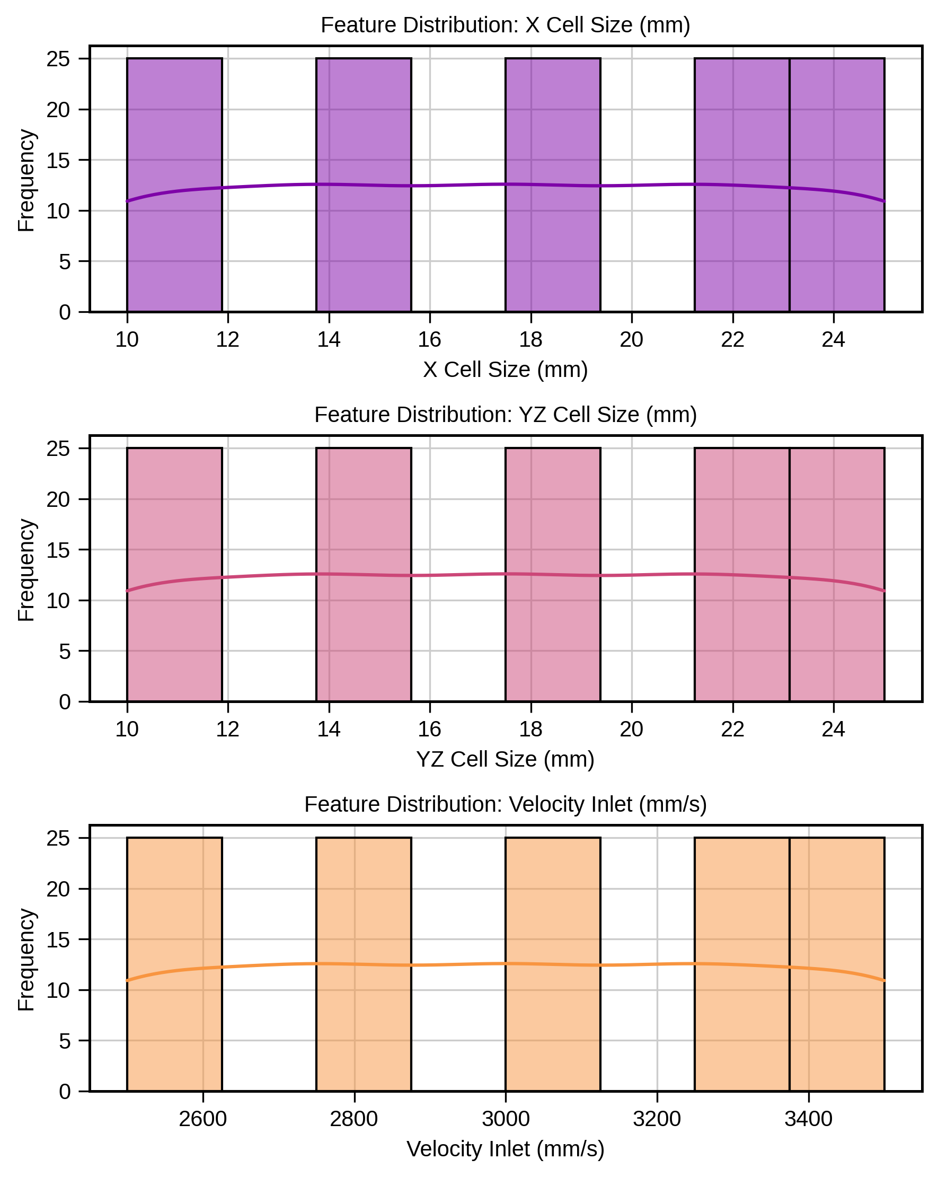
Primary Exploratory Data Analysis
Dataset Overview: 125 data points
Data points appeared in distinct intervals
Possible need for data augmentation
Expand the physical domain knowledge of HEXS
Provide sufficient data for bigger and more dense models (e.g., Neural Networks)

Slide 6
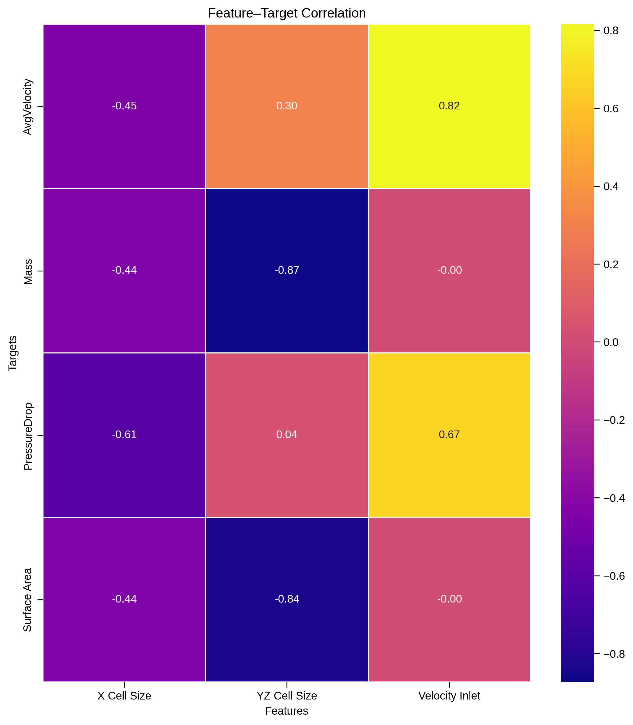
Data Augmentation
Latin Hypercube Sampling to generate well- spread design points
Target correlation analysis for proper sampling
Sampling Design:
15 discrete levels for YZ cell size & inlet vel. (highest impact on targets)
- 5 discrete levels X cell size (moderate impact on targets)

Slide 7
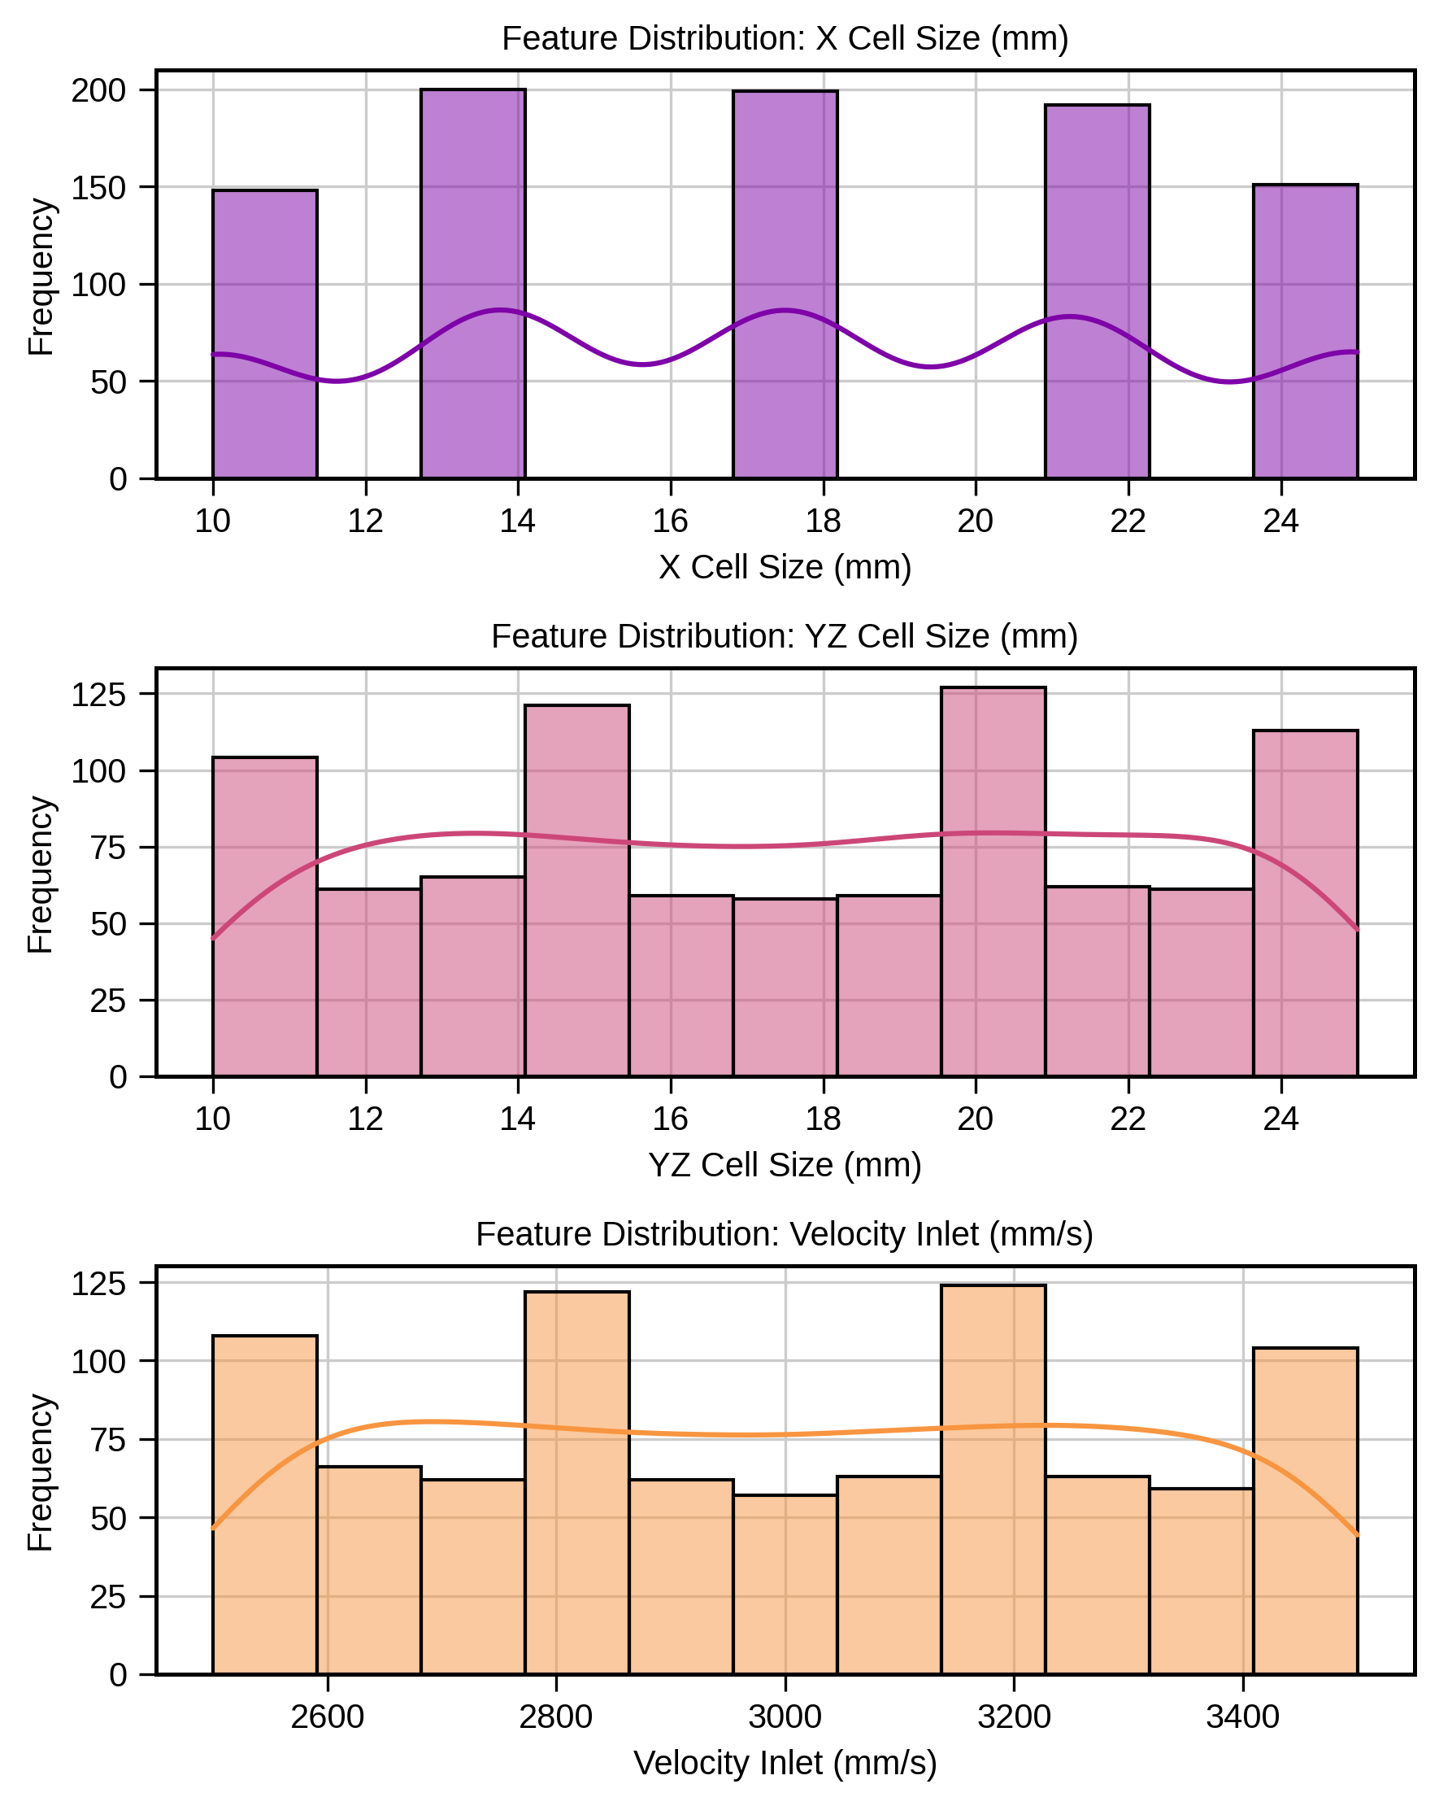
Secondary EDA Comparing Features’ Distribution
initial dataset (125 datapoints)
Augmented dataset (890 datapoints)

Slide 8
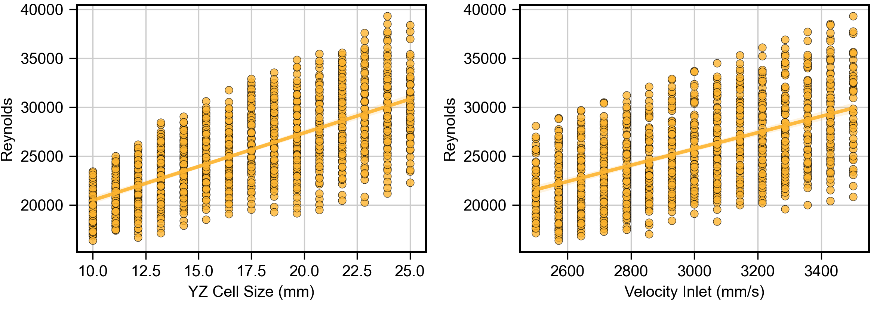
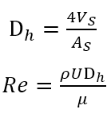
Reynolds Number a physics-informed analysis
Dataset preprocessing
Cold fluid volume extraction from nTop
Calculating hydraulic diameter
Solving for Reynolds number
Reynolds number (Re) analysis
Re increases linearly with inlet velocity (expected)
Scattered Re @ fixed inlet vel. Due to different cell sizes
Cold flow is fully turbulent in the Re range

Slide 9
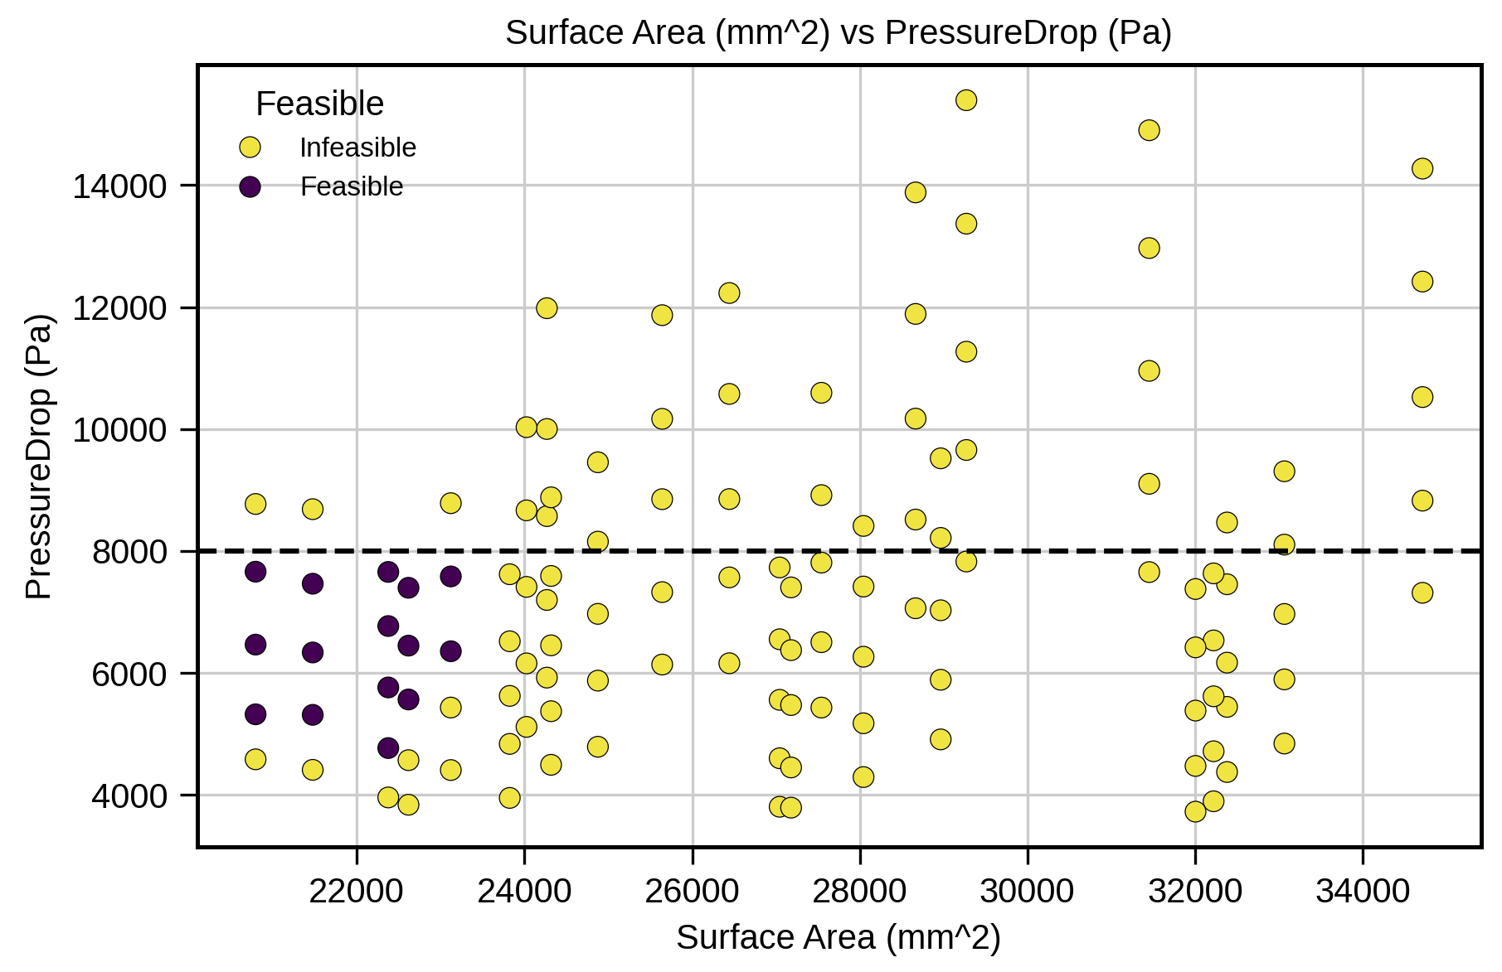
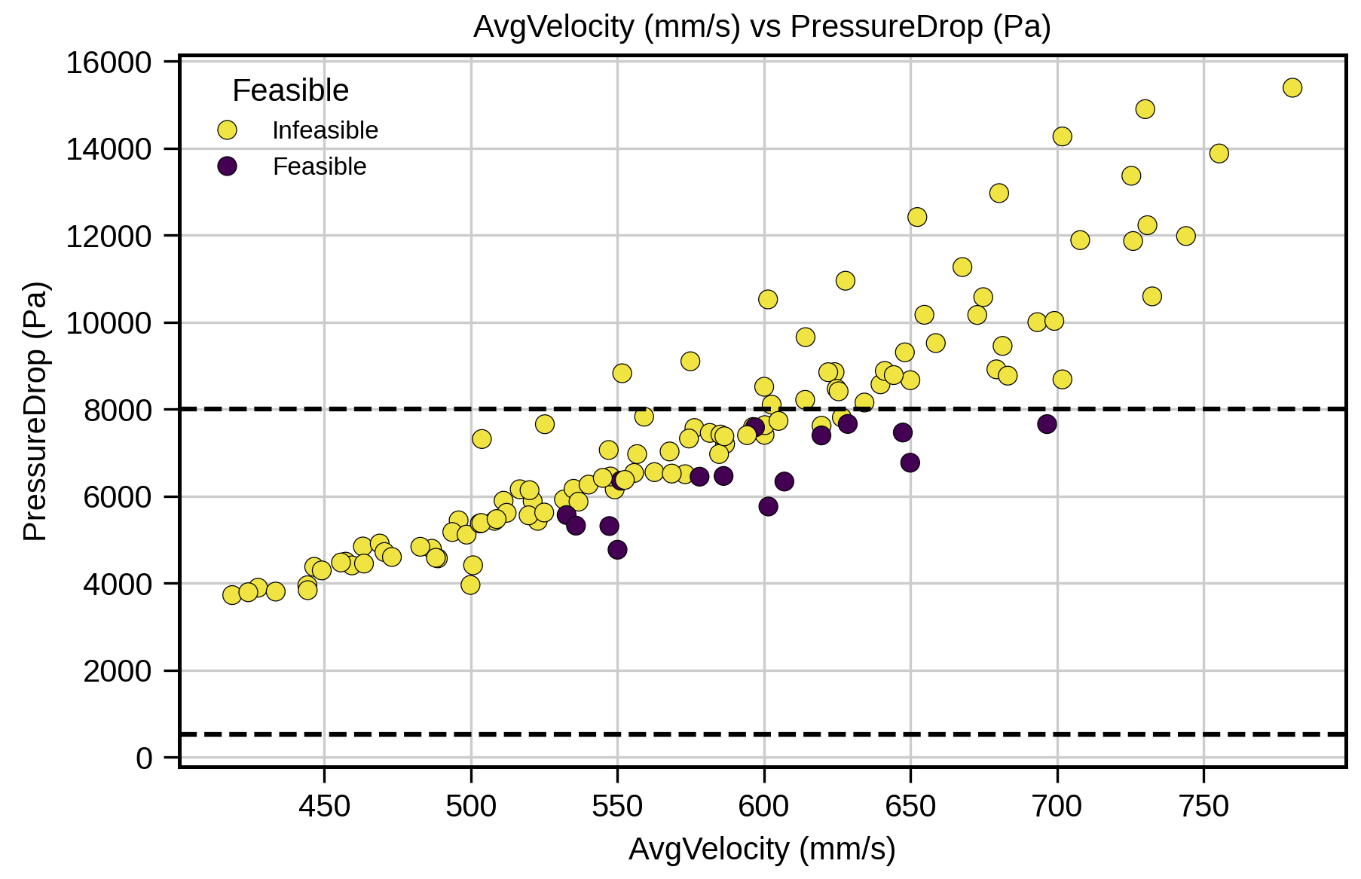
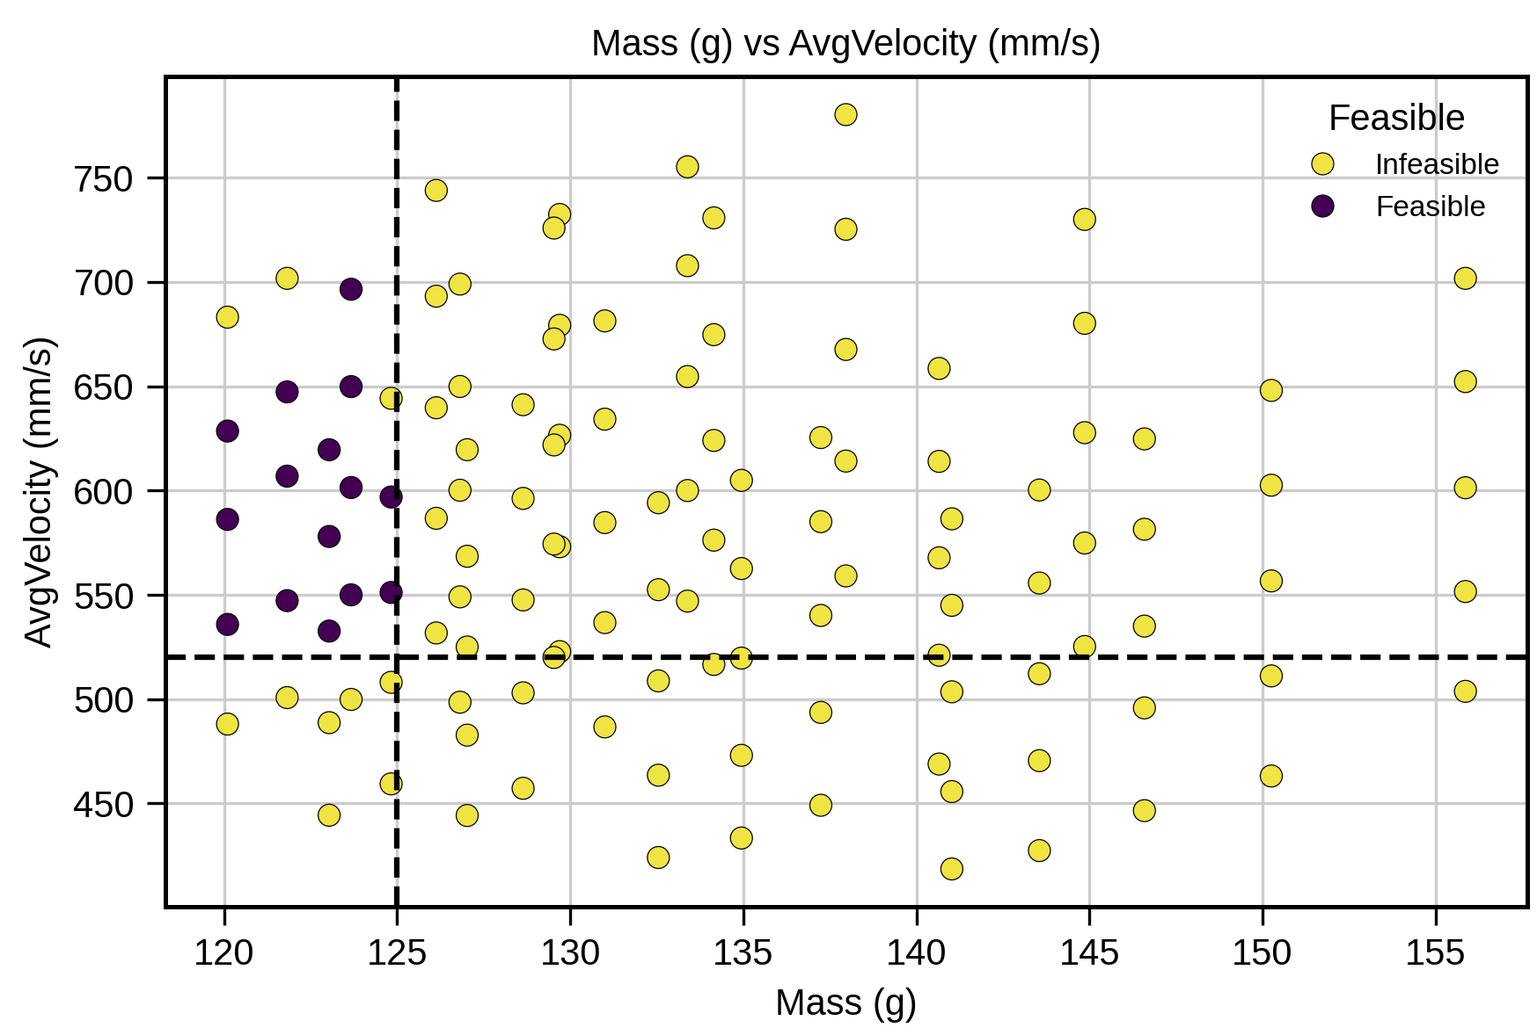
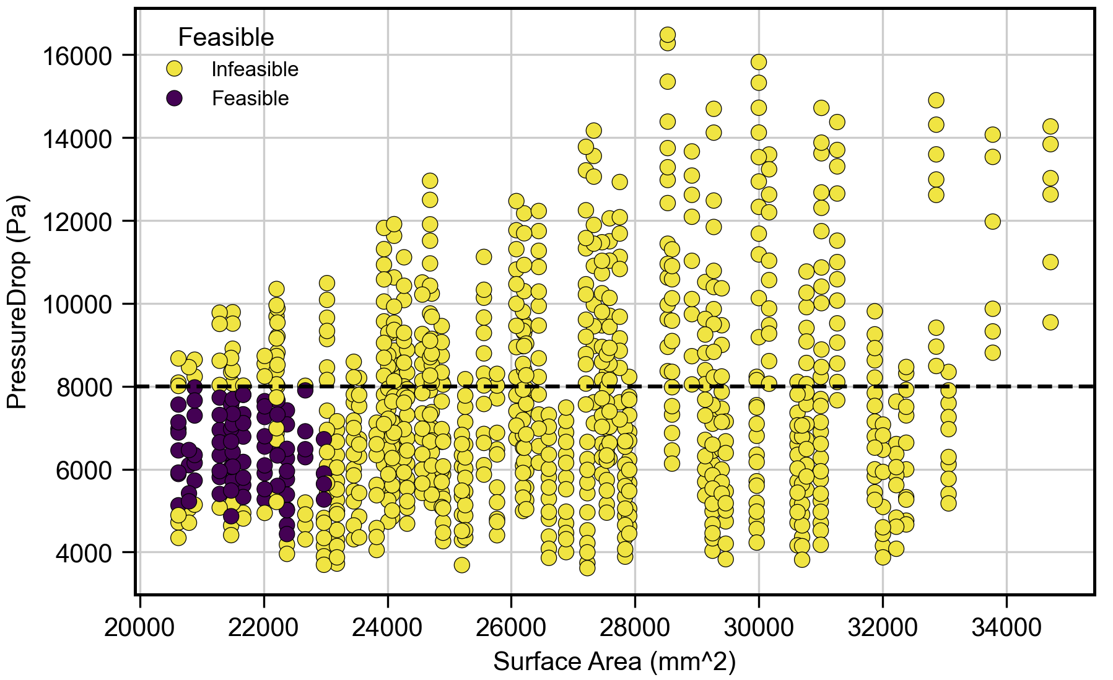
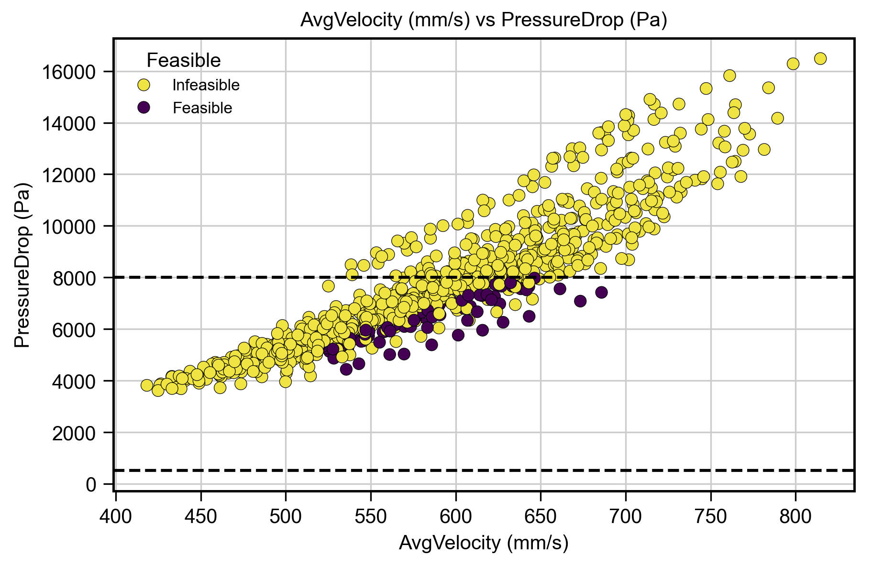
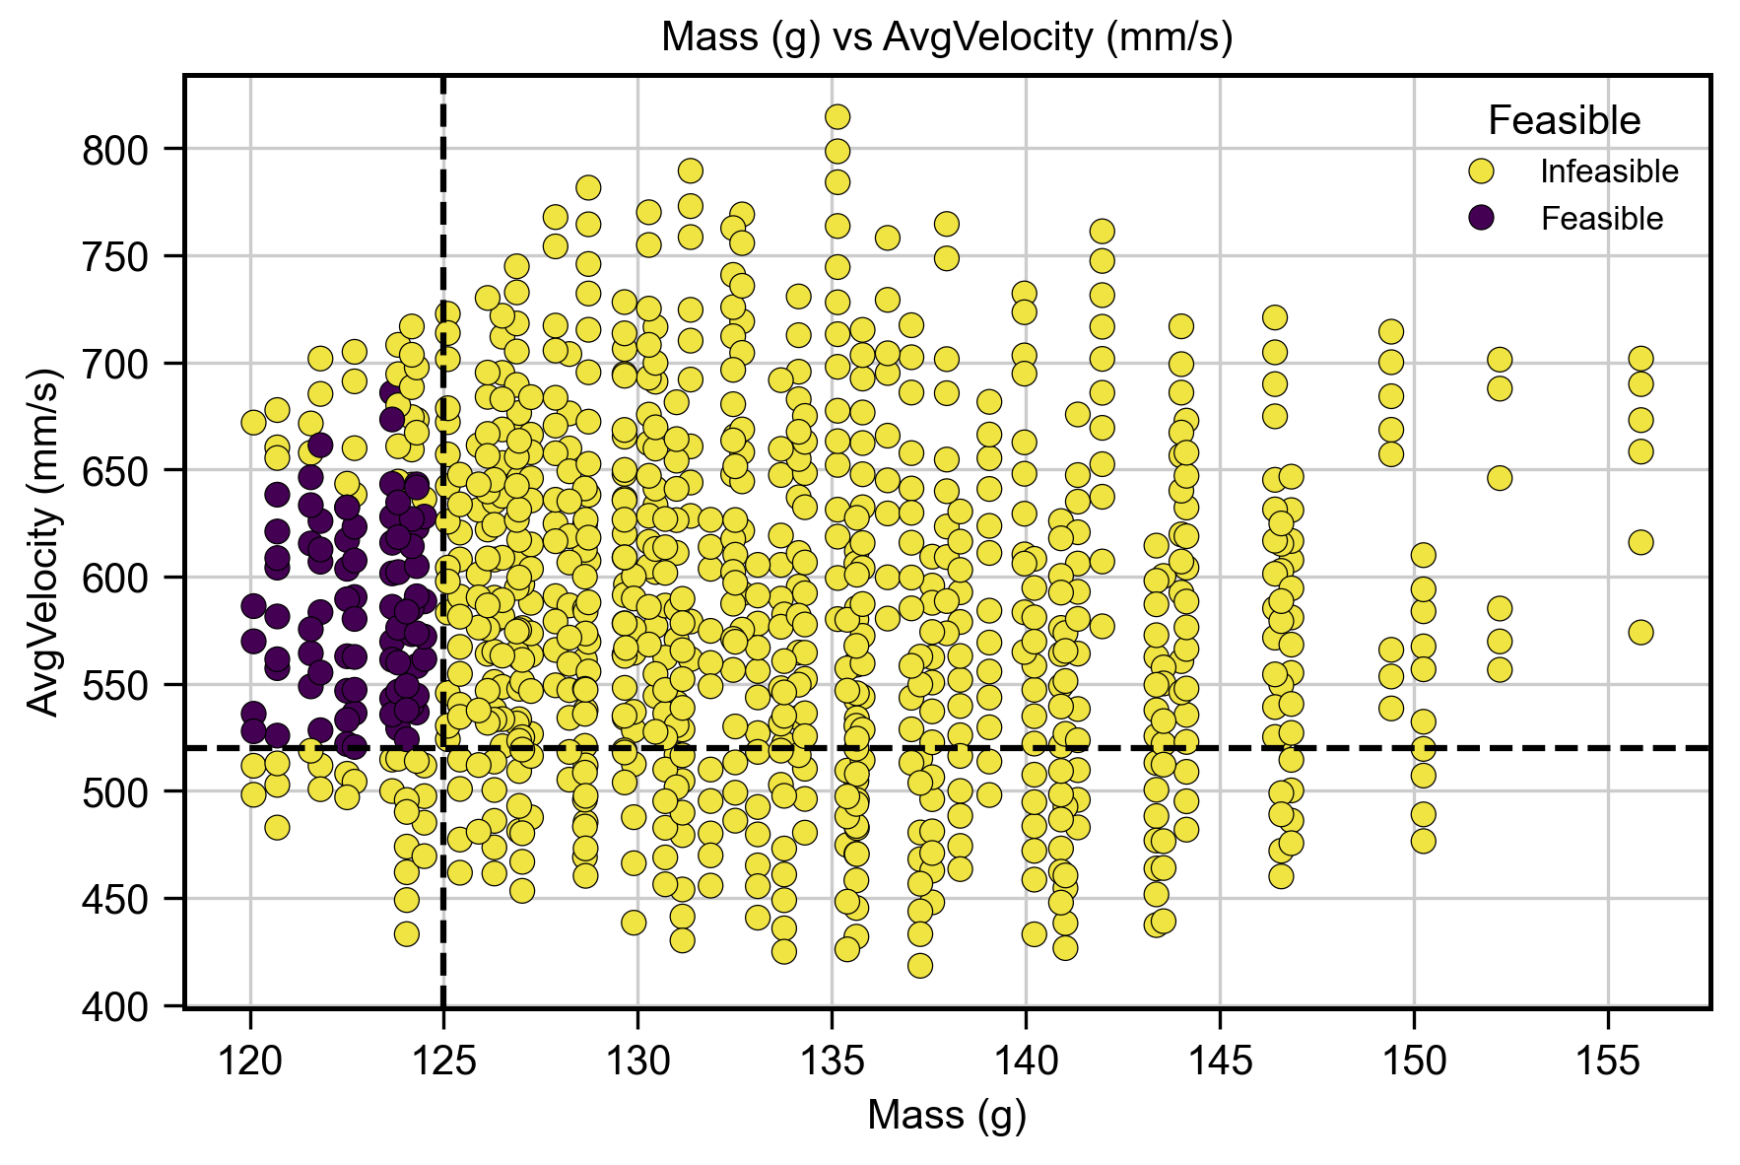
Primary EDA – Feasibility Plots
After data augmentation
After data augmentation

Slide 10
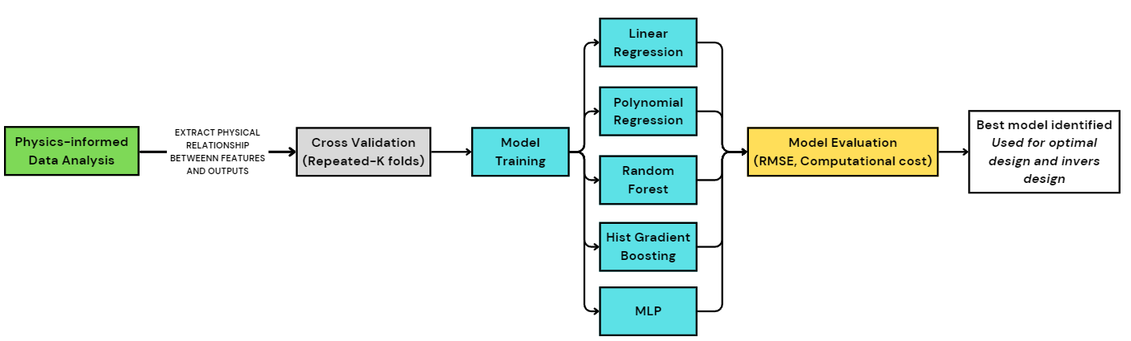
Models Setup-CV + Pipeline
Systematic Pipeline: Preprocessing, scaling, and multi-output regression integrated.
Cross-Validation: Repeated K-Fold (5 splits × 3 repeats = 15 folds) for robust training and reduced variance. It prevents overfitting and tunes the hyperparameters for each model.
Custom Scoring: Defined target-specific RMSE plus a combined metric for fair comparison.
Notes:
CV prevents the risk of overfitting on a part of the data and enhances the model's performance in the whole dataset.
CV is mainly for model selection and hyperparameter tuning.
It estimates how a model might generalize unseen data without committing to a final test set. CV gives a less biased signal for picking the best algorithm before touching the test set. Also, cross-validation before training and testing the model reduces the data leakage.

Slide 11
Models Setup-Models + Evaluations
Models:
Baselines: Linear Regression and Polynomial (degree 2) for linear and quadratic trends.
Ensembles: Random Forest and Histogram Gradient Boosting to capture complex nonlinearities.
Neural Models: MLP (128, 64) with ReLU, regularization, and early stopping for nonlinear mapping.
Models were trained on 80% of the dataset (total: 890), and the other 20% was used to test the models.
Evaluation:
Statistical error metrics and visual comparisons of model predictions against the CFD results.
The best model for accuracy and generality was selected through the comparison framework.
This setup ensured that the surrogate model captured the underlying physics while.

Slide 12
Models Comparison
HistGradientBoosting: Best overall accuracy (Combined RMSE ≈ 471), strong across outputs.
Random Forest: Comparable accuracy, lowest surface area and mass error, slightly higher combined RMSE.
Poly2+LR: Fastest runtime (0.006 s), moderate accuracy — good speed/accuracy trade-off.
MLP (128,64): Captured nonlinearities but underperformed with high runtime (13 s).
Model | RMSE Pressure Drop | RMSE Avg Velocity | RMSE Surface Area | RMSE Mass | RunTime (s)
HistGradientBoosting | 462.14 | 9.19 | 208.43 | 0.76 | 1.68
RandomForest | 473.49 | 13.44 | 45.36 | 0.14 | 1.86
Poly2+LR | 695.33 | 16.34 | 437.14 | 0.42 | 0.006
MLP (128,64) | 746.04 | 15.51 | 373.48 | 0.41 | 12.93
LinearRegression | 1015.01 | 19.00 | 976.78 | 1.72 | 0.005
Notes:
Data Limitation: Current dataset (890 points) is sufficient for ML but too small for deep neural networks to generalize well.
Conclusion: Tree-based ensembles (HGB, RF) provide the best balance of accuracy and computational cost, making them the most reliable for surrogate modeling and inverse design.

Slide 13
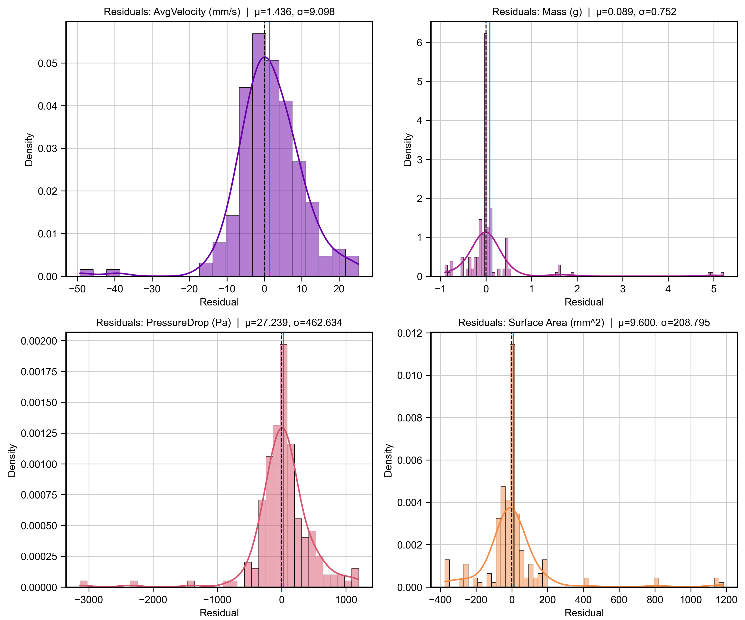
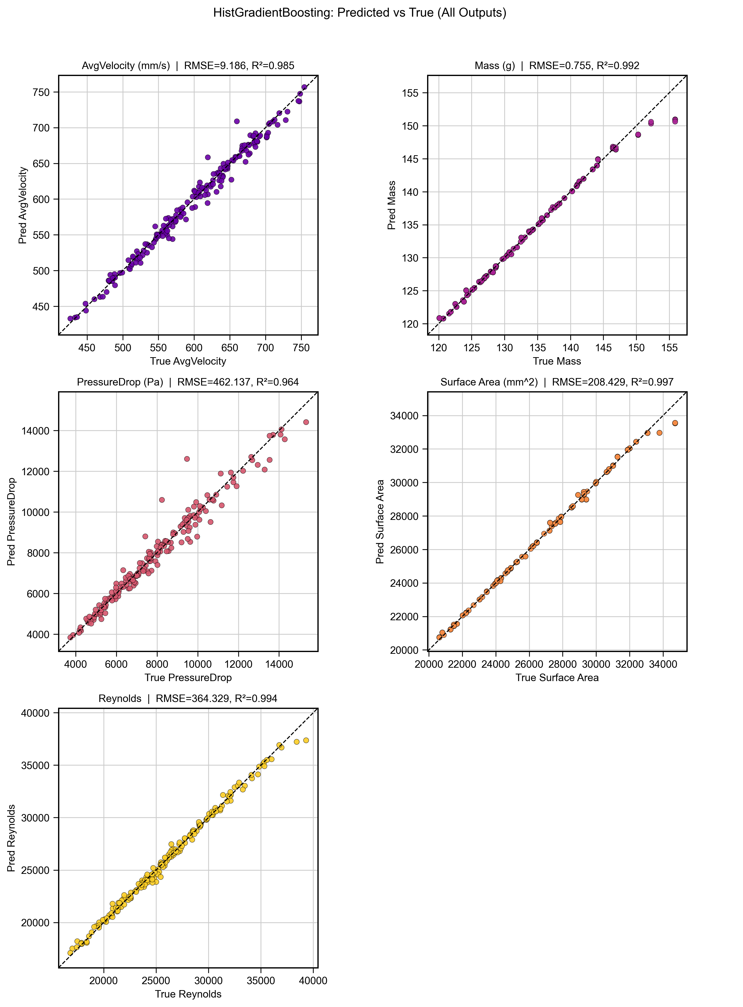
Model Predictions-HGB

Slide 14
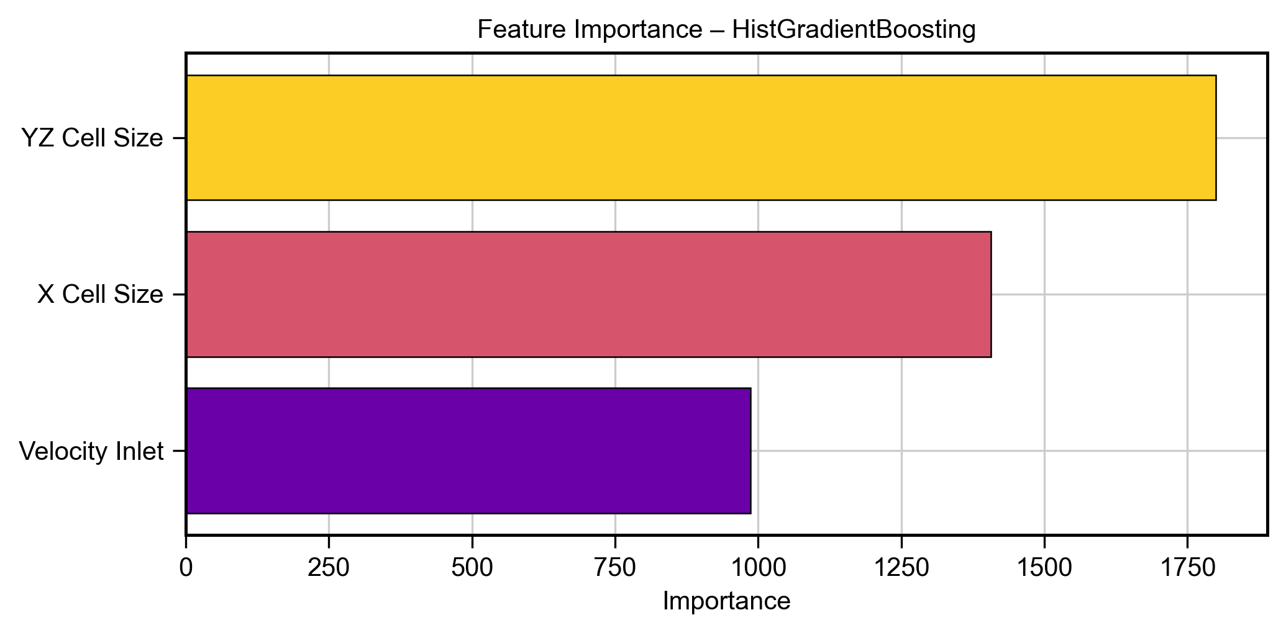
Model Prediction-Unseen Data/Cases
It is necessary to evaluate the efficiency and practicality of the model against unseen data.
Also, the feature importance for the HGB (best model) was analysed, which satisfied the reasons behind data augmentation. This should be noted when using inverse design as well.
Model Prediction Accuracy
Tested on 8 random input cases.
Target Outputs | Model Prediction vs. nTop Error (%)
Average Velocity | 2.73
Pressure Drop | 7.53
Surface Area | 2.93
Mass | 2.86

Slide 15
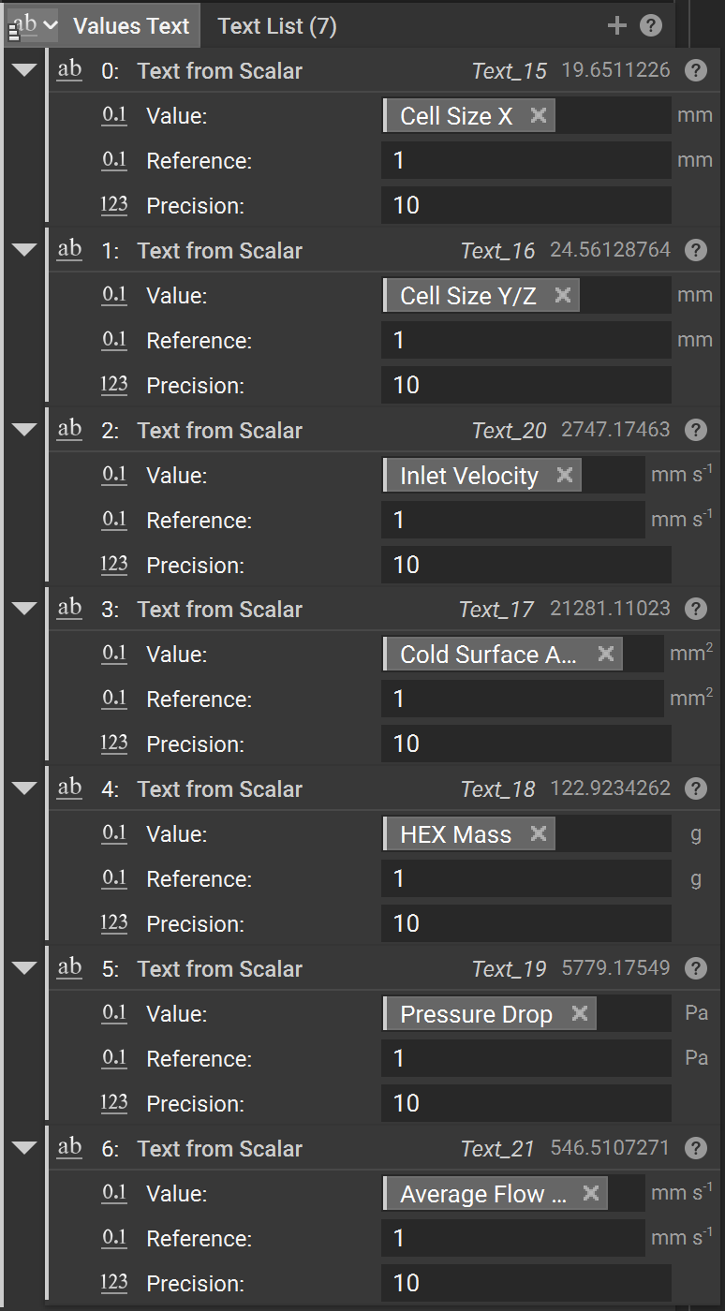
Inverse Design
A progressive Latin Hypercube Sampling (LHS) strategy was chosen to determine the optimal lattice design for the HEXs.
Design space is iteratively zoomed in around the best feasible point, and the surface area is maximized while mass, pressure drop, and velocity constraints are enforced.
Target Outputs | HGB Predcition | nTop
Average Velocity | 537.56 | 546.51
Pressure Drop | 5124.33 | 5779.17
Surface Area | 21516.2 | 21281.11
Mass | 121.82 | 122.92
Optimal Design suggested
Cell X:19.6511226
CellYZ: 24.56128764
V-inlet: 2747.17462971
Mass < 125 grams
Pressure Drop < 8000 Pa
Avg Velocity > 520 mm/s^2

Slide 16
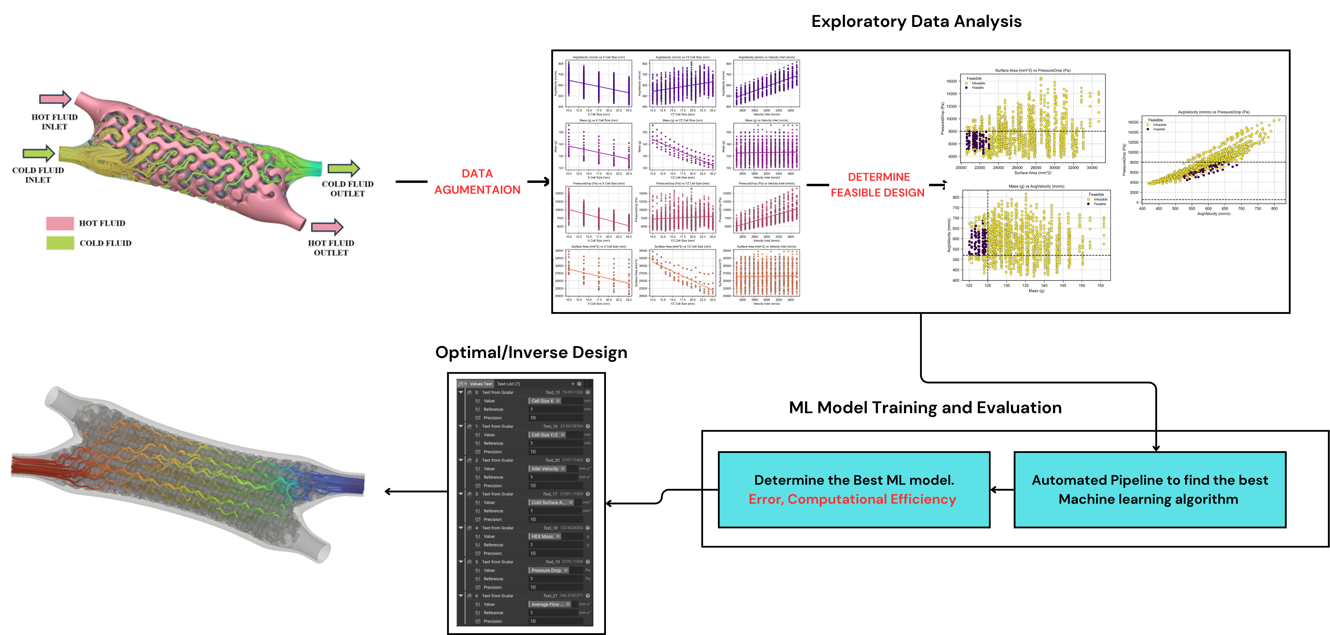
Potential applications and broader implications
Applications:
Coupled surrogate–CFD approach
Lattice-based structures’ FEA analysis
Porous media simulations
Additive manufacturing process modeling
Notes:
Expand the domain’s physical knowledge of simulations using CFD, FEA, or, in some cases, experimental cases.
Determine the problem carefully, and how to incorporate physical law into the data or into the algorithms (e.g., more features and add PDE in the loss function)
We will use automated pipelines to train a few algorithms and find the best ML algorithm suitable for our problem.

Slide 17
Key takeaways-Future Works
Physics-informed surrogate modeling successfully replaced computationally expensive CFD for heat exchanger optimization, cutting evaluation time from hours to milliseconds.
Physics-informed exploratory data analysis (EDA) would further help us understand the domain of the training ML models and augment the data.
Inverse design optimization identified optimal HEX geometry and flow parameters (e.g., X = 19.65 mm, YZ = 24.56 mm, velocity = 2747 mm/s) that maximize surface area while satisfying mass, velocity, and pressure constraints.
Eight different sets of input parameters were utilized as unseen data to examine the model’s performance compared to nTop.
Future works:
Integrating physics-based empirical equations to enhance model accuracy
In-depth analysis of data point efficacy and coverage to optimize prediction performance
Expand the data to 5 to 10 thousand, ideal for training neural networks.

Slide 18
Thanks!
Any Questions?

